Slide 1

Campus Eats
Group 18: Kelsey Locaylocay, Brian Colclough, Vanessa Liaw, Meselech Elala, Tia Vang
Notes:
Meselech

Slide 2
Project Description
The importance and the need of delivery services has increased over the years
Increase in employment
New ways of dining
COVID friendly
Enhancing the existing database to including a rating system
Implementing new attributes and entities to assist our rating system
Notes:
Meselech

Slide 3
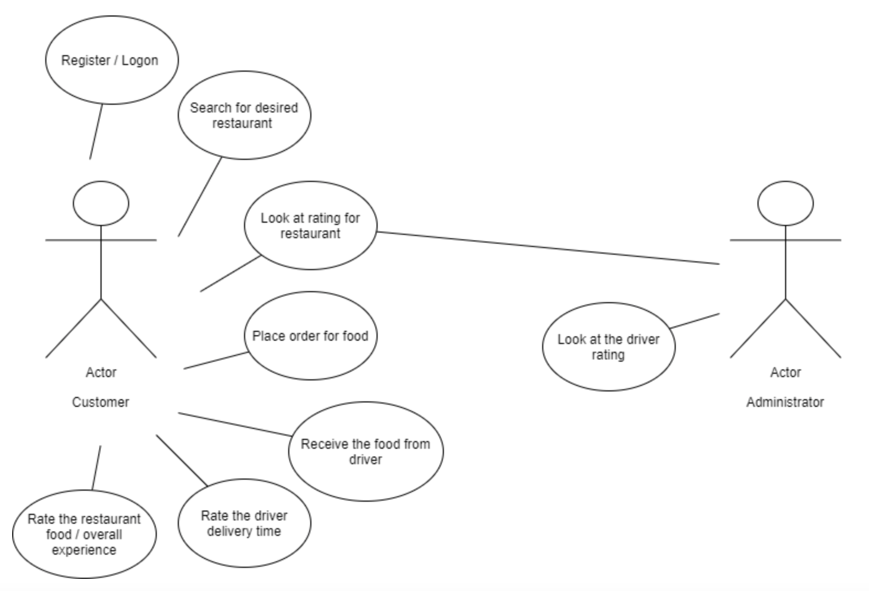
Use Case
Notes:
Brian

Slide 4
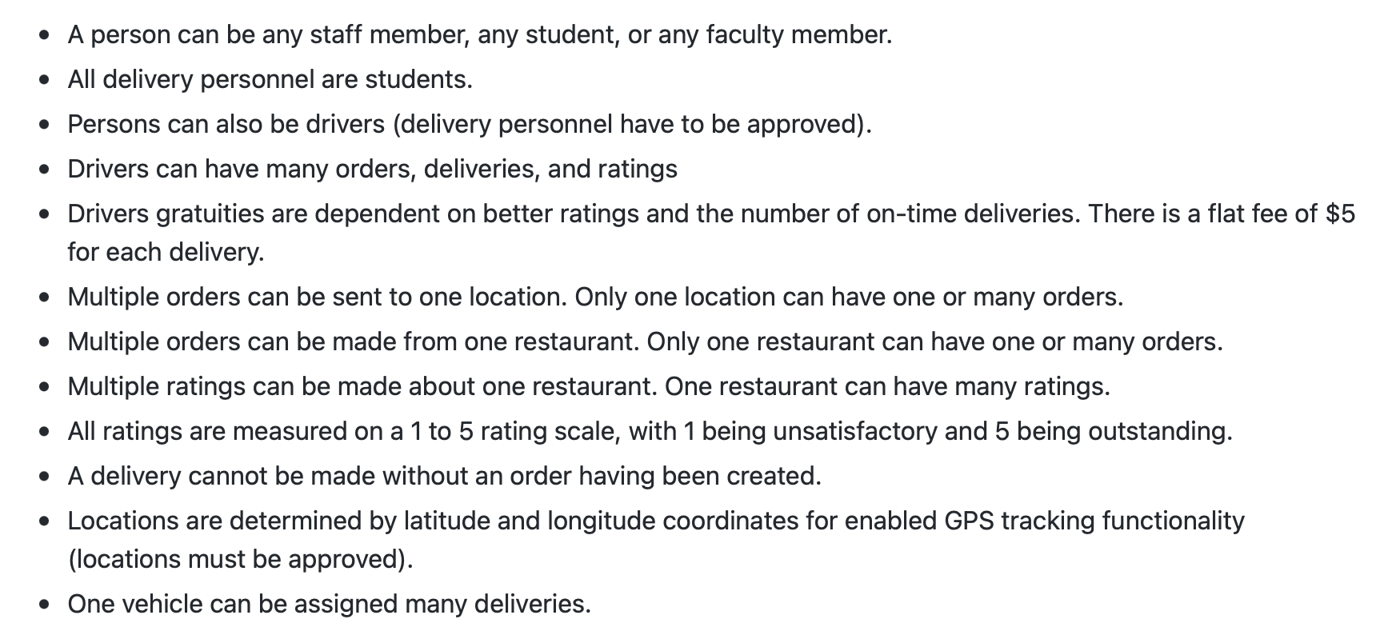
Business Rule
Notes:
Vanessa

Slide 5
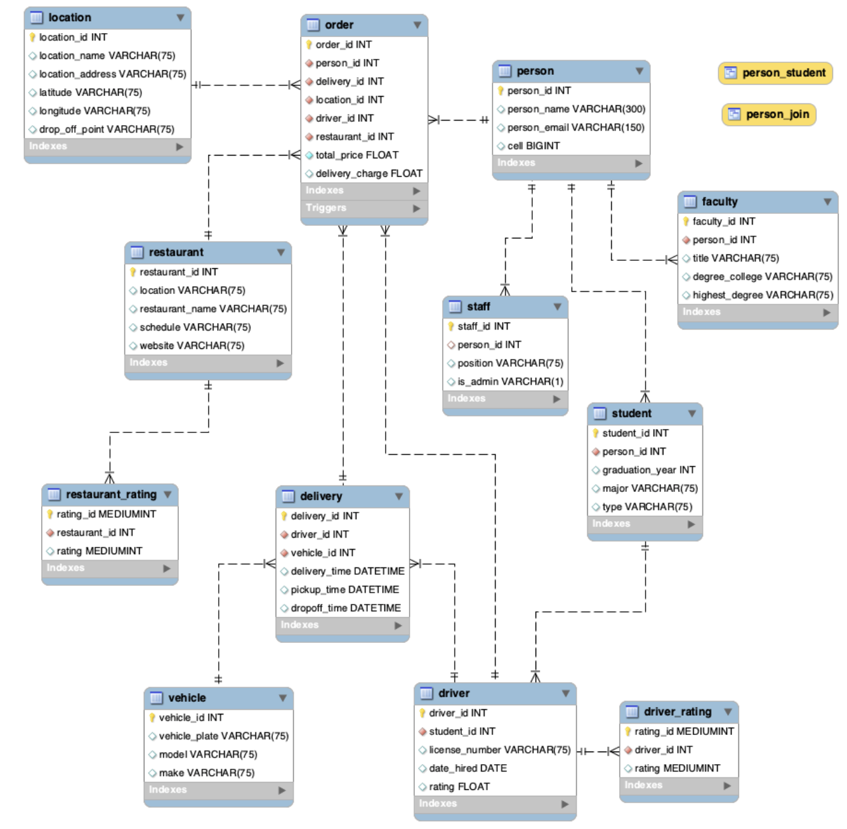
EERD
Notes:
Vanessa

Slide 6
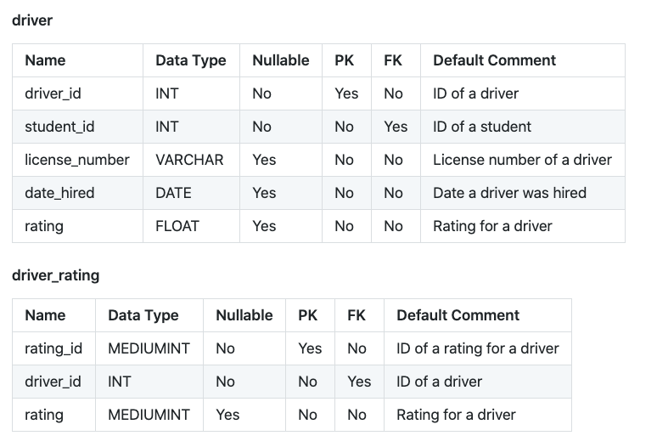
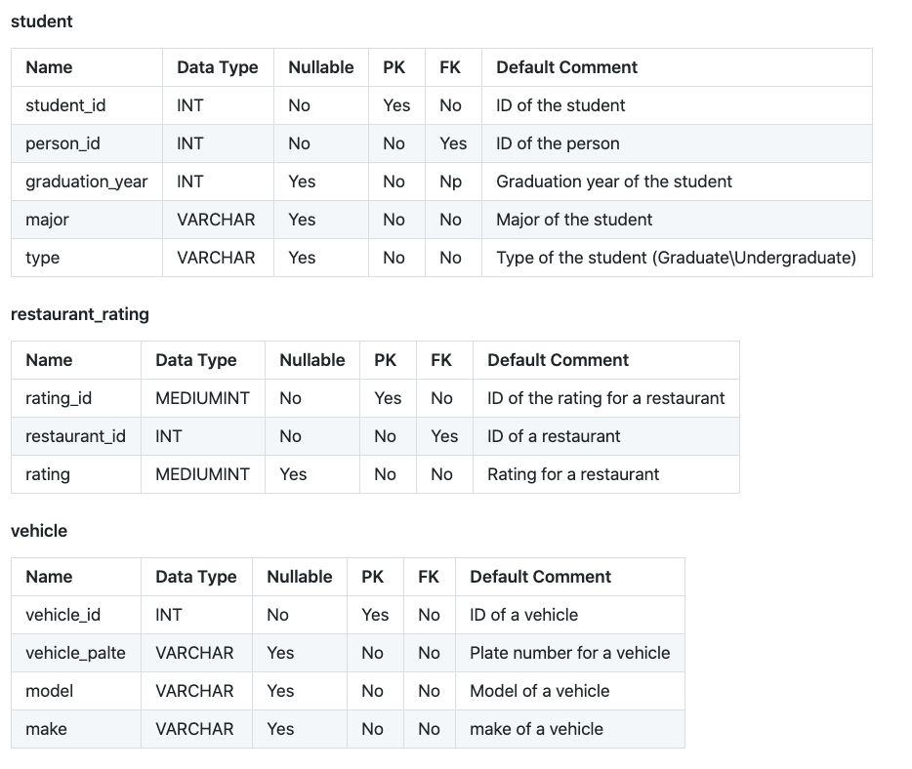
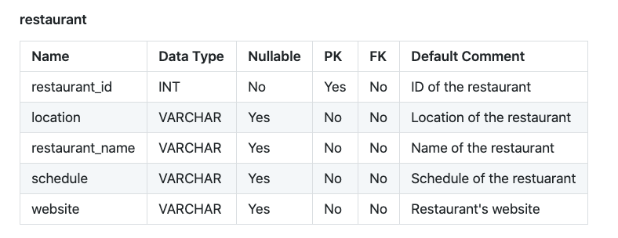
Data Dictionary
Notes:
Brian

Slide 7
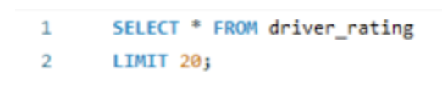
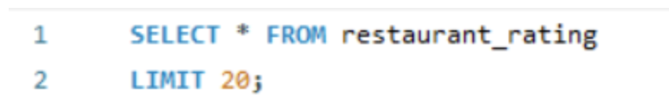
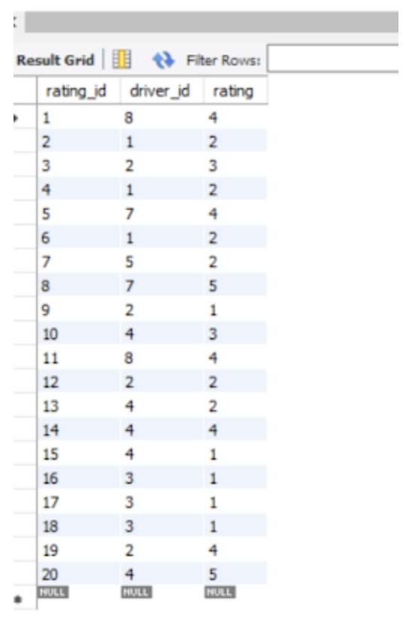
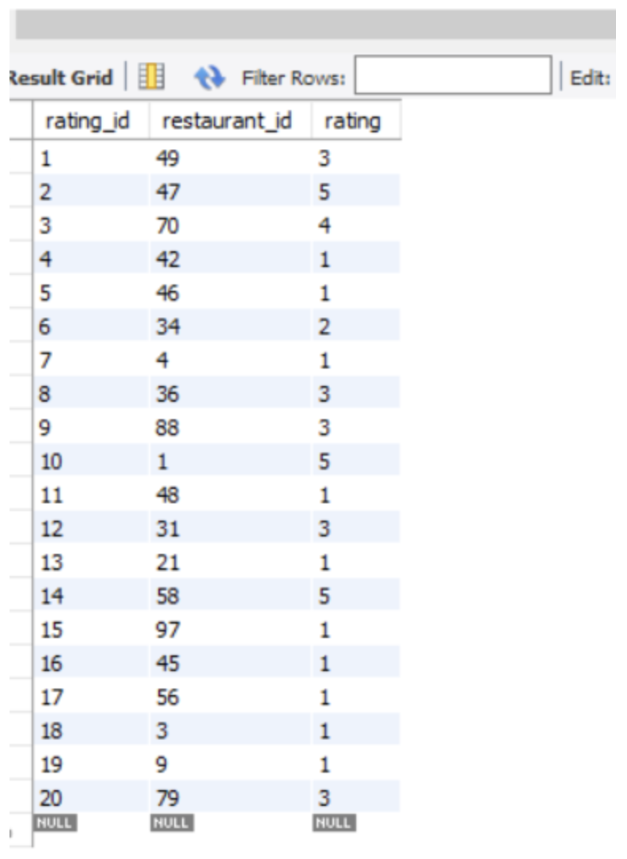
MySQL Queries
Driver Rating Table
Restaurant Rating Table
Notes:
Tia

Slide 8
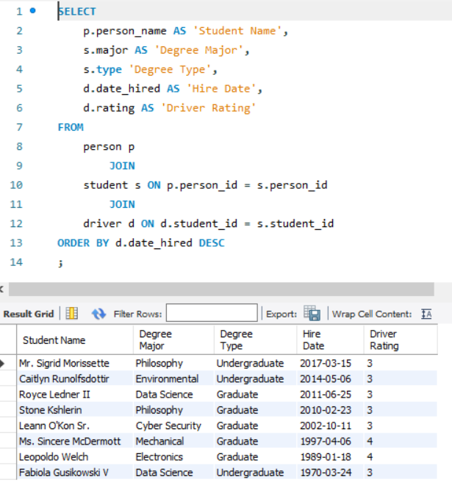
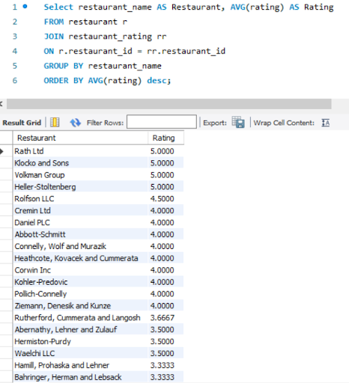
Relationships with SQL Scripts
Notes:
Tia

Slide 9
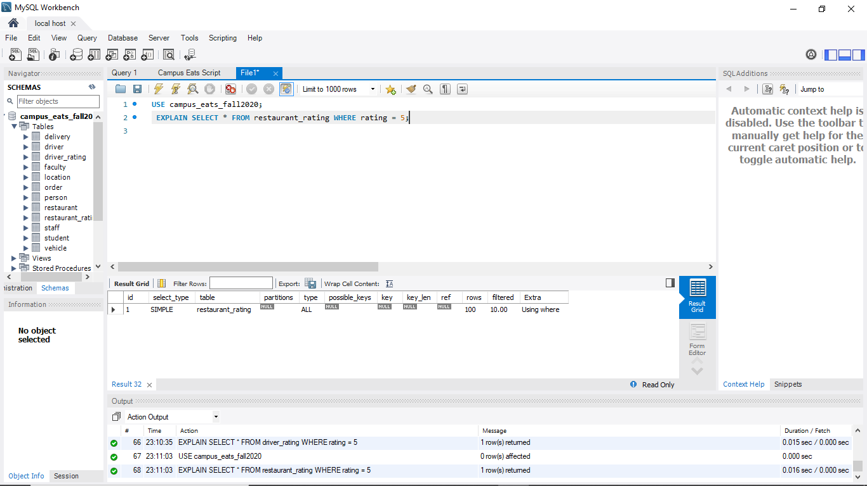
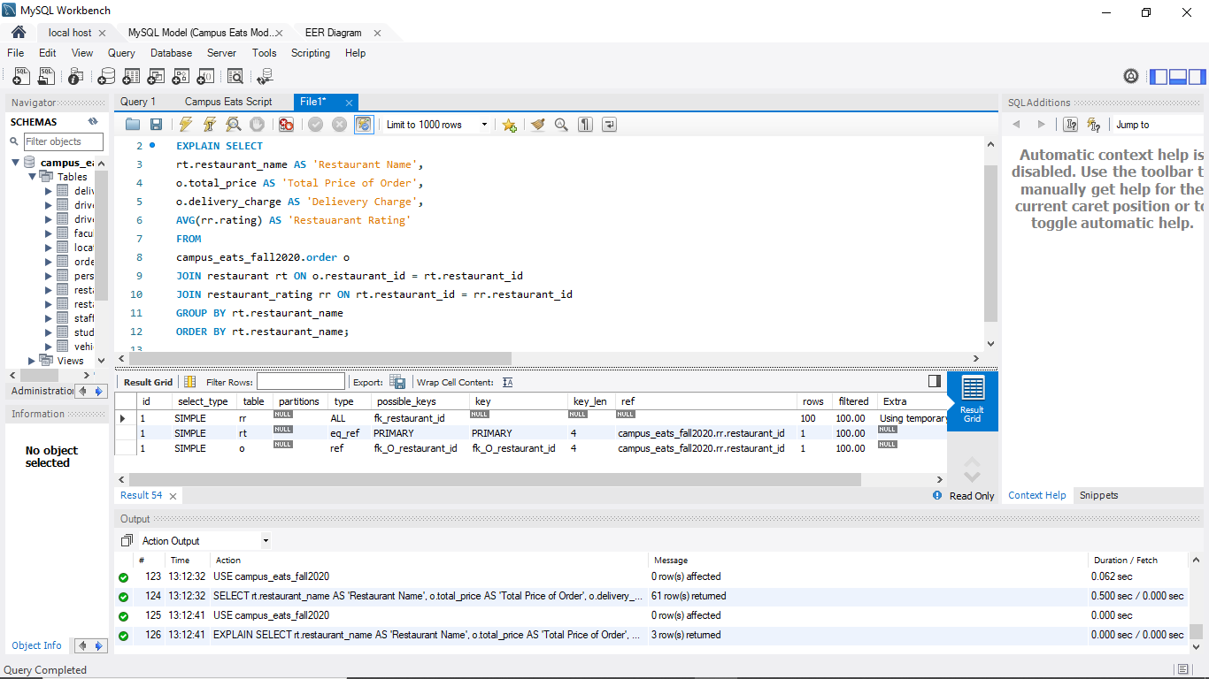
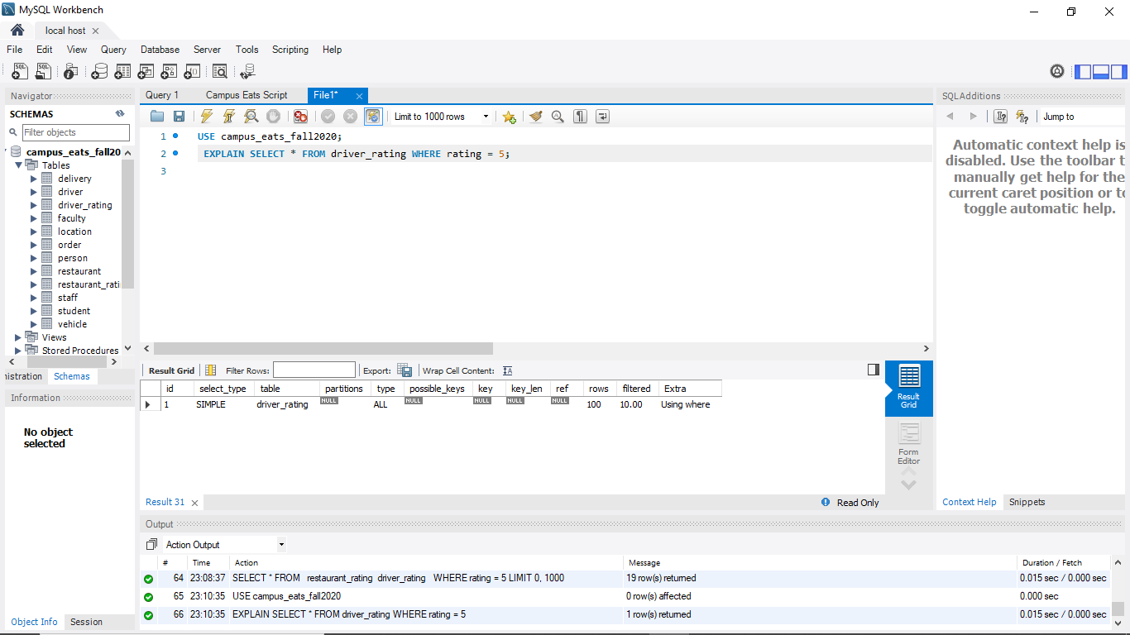
Query Optimization
Notes:
Meselech

Slide 10
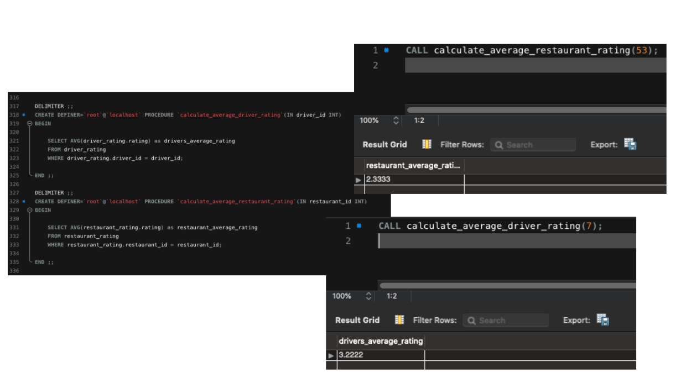
Stored Procedure
Notes:
Kelsey

Slide 11
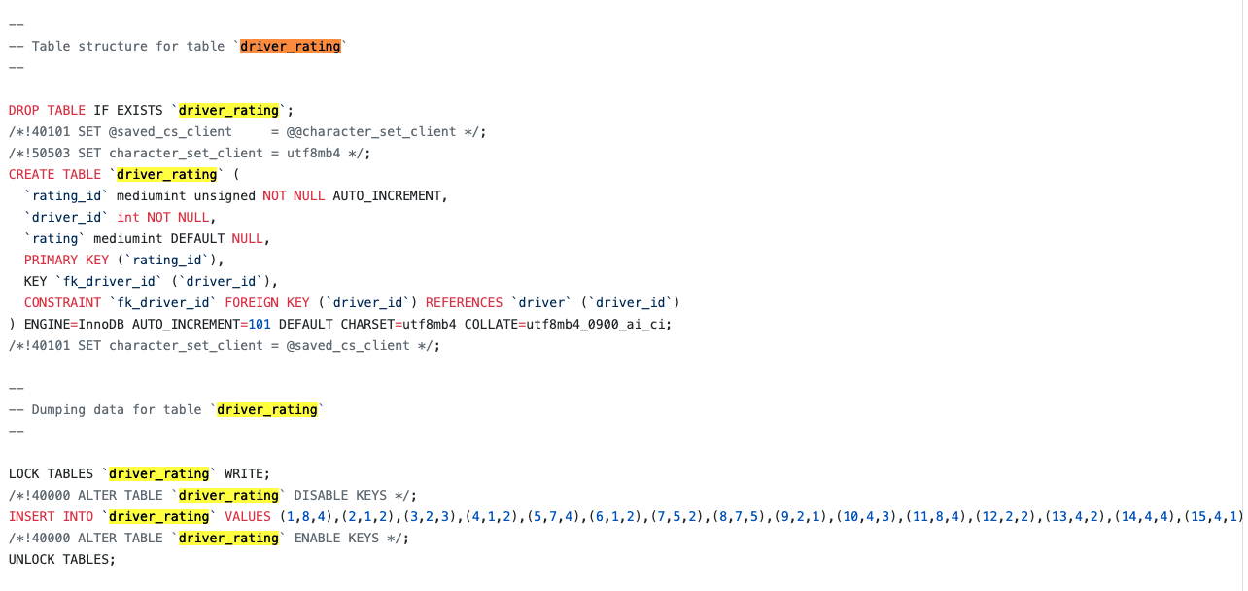
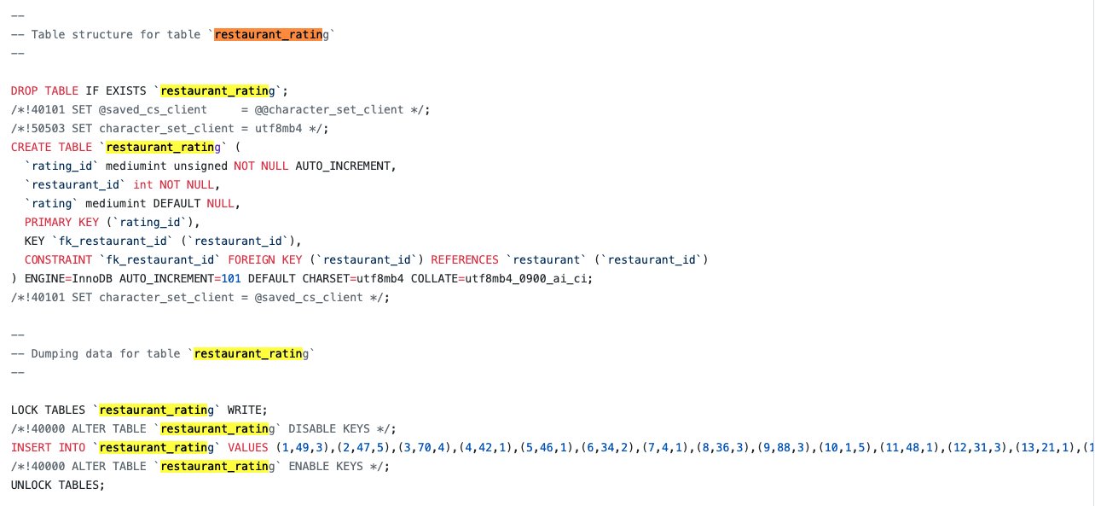
SQL Dump
Notes:
Kelsey

